Slide 1
Migration in Sweden
Project for the Course
Information Visualization (TNM048) Willem Frishert Cristina Vozian

Slide 2
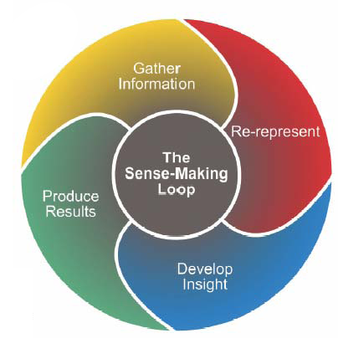
Outline
Acquiring data
Re-representing
Developing insight
Usability study
Conclusion

Slide 3
Acquiring data
Migration Data
    Migration to Sweden from other countries and from Sweden abroad
    Migration within Sweden
Additional Data
    Environmental, Energy, Labour market, Public finances, Education, Living conditions and Household finances

Slide 4
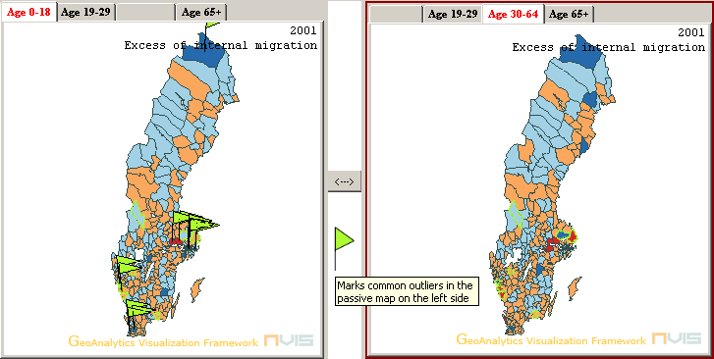
Re-Representing (1)
Active and Passive Map
  Flags
Parallel Coordinates Plot
  Outliers (IQR)

Slide 5
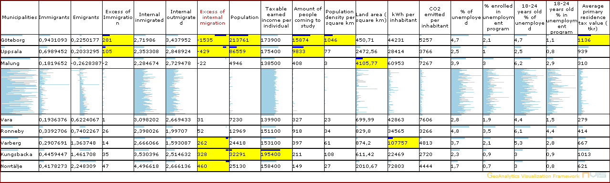
Re-Representing (2)
Table Lens
  Context & Focus

Slide 6
Developing insight
Confirmatory Analysis
  Hypotheses
Exploratory Analysis

Slide 7
Usability Study
Perform tasks
Test usability
Analyze results

Slide 8
Conclusion
Improvements for the application
  Eliminate the lag in the program
  Change the flag glyph (no overlap)
  Emphasize the value of a variable in the table lens
  Show all migration data
  Help functionality

Slide 9
DEMO

Slide 14
